Slide 1

Chapter 7: Raspberry Pi projects

Slide 2
LED GPIO: Description
Connect LED to GPIO pin 18 of Raspberry Pi
Turn LED on and print(“LED ON”)
Delay 1 second
Turn LED off and print(“LED OF”) and repeat

Slide 3
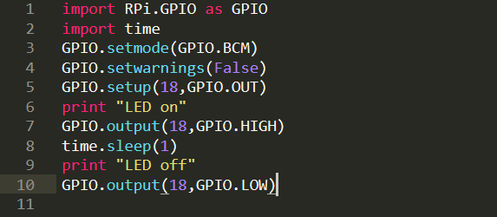
LED GPIO
Code for Raspberry Pi:
Device: led, resistor, board
Pin: 18
Module: Rpi.GPIO, time

Slide 4
Gas sensor MQ8: description
Connect MQ8 to the GPIO pin 18, VCC, GND
Read the data every 1 second
Check if the data equal to 1, then print(“No Gas”)
Check if the data equal to 0, then print(“Warning: Gas”)

Slide 5
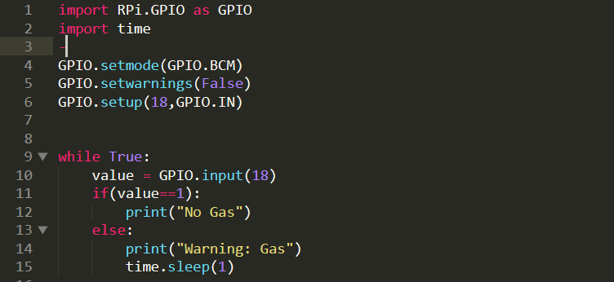
Gas sensor MQ8
Code for Raspberry Pi:
Module: Rpi.GPIO, time
Devices: MQ8, Board

Slide 6
Send data from Arduino to Raspberry Pi via UART: description
Send string “1” from the Arduino through Serial with baudrate: 9600
Receive the data via UART connection with Raspberry Pi
Print the Data string “1”

Slide 7
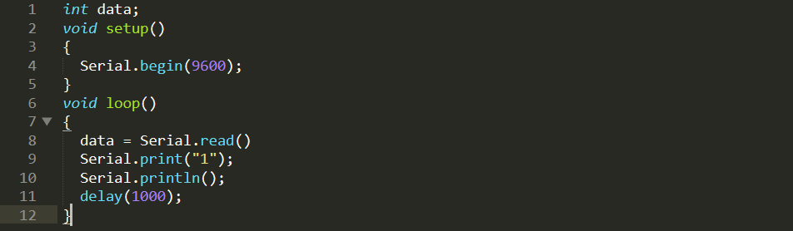
Send data from Arduino to Raspberry Pi via UART
Code for Arduino:
Communication: Serial
Baudrate: 9600
Port: ttyACM0

Slide 8

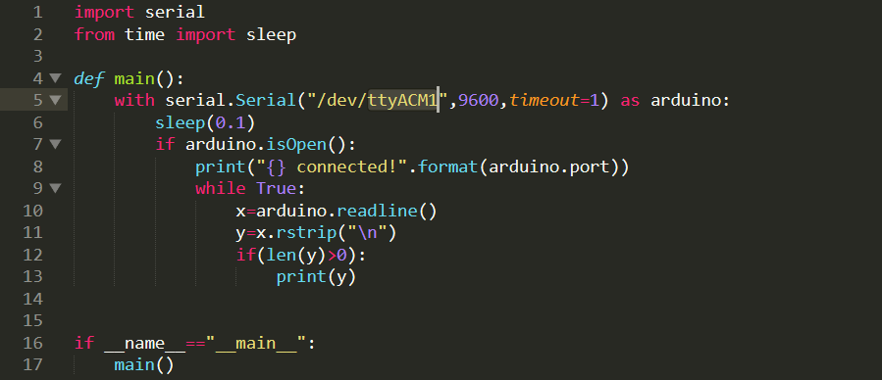
Send data from Arduino to Raspberry Pi via UART
Code for Raspberry Pi:
Communication: Serial
Baudrate: 9600
Port: ttyACM0
Module: serial, time

Slide 9
Send data from Raspberry Pi to Arduino via UART: description
Send number counting from 1 from the Raspberry Pi through Serial with baudrate: 9600
After 1 second the number automatic plus 1
Receive the data via UART connection with Arduino
Print the Data number in the Arduino

Slide 10
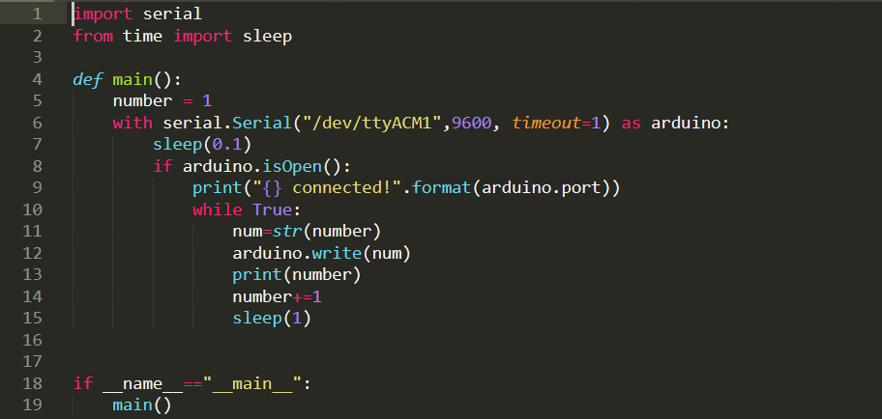
Send data from Raspberry Pi to Arduino via UART
Code for Raspberry Pi:
Communication: Serial
Baudrate: 9600
Port: ttyACM0
Module: serial, time

Slide 11
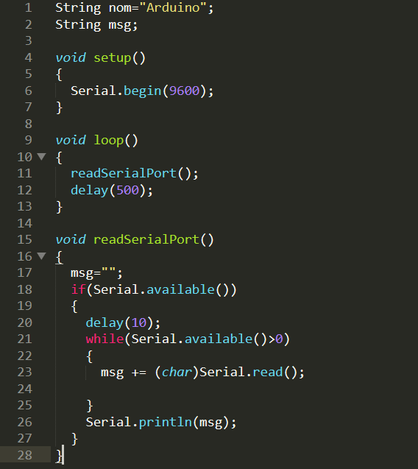
Send data from Raspberry Pi to Arduino via UART
Code for Arduino:
Communication: Serial
Baudrate: 9600
Port: ttyACM0

Slide 12
LM35: Temperature monitor in csv file description
Read the ADC value of the sensor LM35 by the Arduino
Send the temperature through Serial to the Raspberry Pi
Take the RTC time in Linux system
Open file temp.csv and write the temperature and RTC time in the file

Slide 13
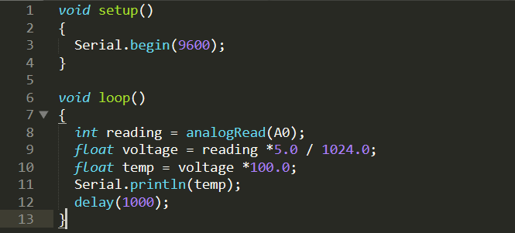
LM35: Temperature monitor in csv file
Code for Arduino:
Communication: Serial
Baudrate: 9600
Port: ttyACM0
ADC: Pin A0

Slide 14
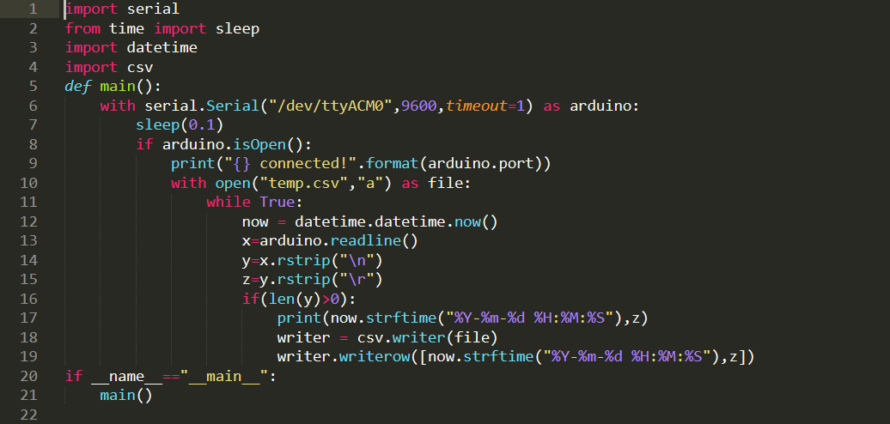
LM35: Temperature monitor in csv file
Code for Raspberry Pi:
Communication: Serial
Baudrate: 9600
Port: ttyACM0
Module: serial, time, datetime, csv

Slide 15
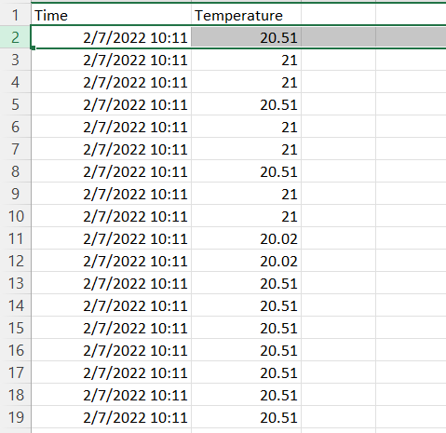
LM35: Temperature monitor in csv file
File CSV saved data of temperature and RTC time:

